Slide 1



Advanced Calculator
Built with Python and Tkinter
Basic, scientific, converter and graph calculator
NEXTHIKES IT SOLUTIONS
MD SHAHNSHAH
Notes:
Introduce yourself and the project: Project 2 of NextHikes IT Solutions, a calculator GUI built with Python and Tkinter.

Slide 2


Introduction
A desktop calculator built with Python and Tkinter. It goes beyond the basic task: scientific functions, history, a unit converter, a maths graph and a data graph. Every key is drawn in code, so the look is fully custom.
7
Tabs in one app
15
Currencies supported
7
Converter categories

Slide 3





Project Requirements
Display Screen
Clickable Buttons
Core Operations
Equals and Clear
Shows the expression and the result.
Number, operator and function keys.
Addition, subtraction, multiplication and division.
= gives the result, C clears the screen.
All four requirements are met, plus extra features.

Slide 4
Basic to Advance
Required (Basic)
My Advanced Calculator
Display screen
Digit buttons 0 to 9
+ − × ÷
Equals (=) and Clear (C)
Scientific, Trigo and Func tabs
Memory keys and history
Unit and live currency converter
Maths graph and Data graph (CSV / Excel)
Dark and Light theme
Resizable window with History panel

Slide 5



Tools and Technologies
Python
Tkinter
Core logic with math, ast, re and decimal modules.
Window, Canvas, events and smooth animations.
Visual Studio Code
GitHub
IDE used to write, run and debug the script.
Hosts the project code for submission.
Everything works offline except the live currency rates.

Slide 6








Feature Overview
Home
Scientific
Trigo
Func
History
Converter
Graph
Basic maths and memory
Powers, roots, logs
sin, cos, tan, DEG and RAD
GST, EMI, nPr, nCr
Past results
Units and currency
Maths graph and
data graph
Extras: 3D keys drawn in code, slide animations, keyboard and clipboard support.

Slide 7
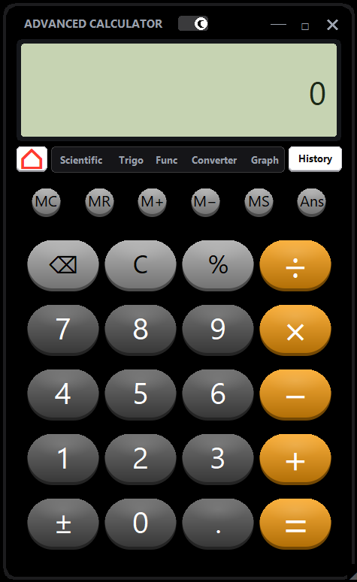
Basic Calculator
Operations
1
Add, subtract, multiply, divide, equal etc. with a live result preview.
Phone-style percent
2
Typing 200+10% gives 220, like a phone calculator.
Memory keys
3
MC, MR, M+, M−, MS and Ans store and recall values.

Slide 8
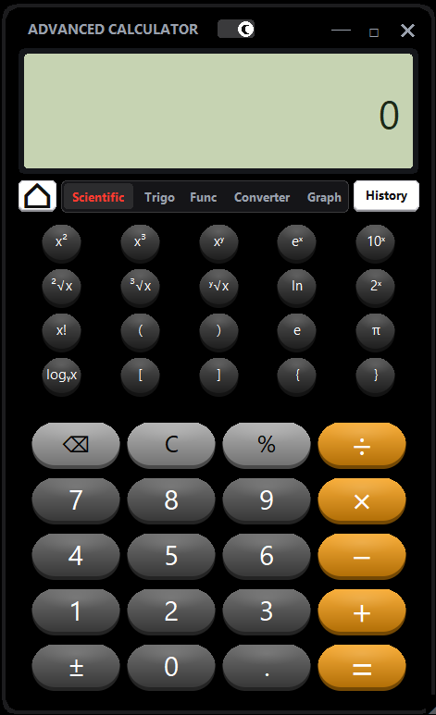
Scientific Panel
Powers and roots
1
Square, cube, x^y, roots, e^x and 10^x.
Logs and factorial
2
ln, log, log of any base, x^2, x^3, e^x and x! etc.
All bracket types
3
Round ( ), square [ ] and curly { } brackets work.

Slide 9
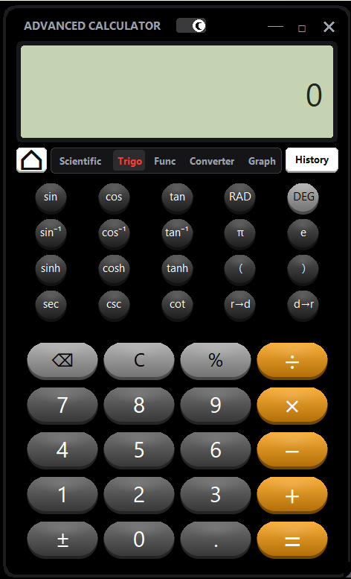
Trigonometry
Full trig set
1
sin, cos, tan with inverse and hyperbolic versions.
DEG and RAD
2
Switch the angle mode; it shows on the LCD.
Extra helpers
3
sec, csc, cot and radian-degree converters.

Slide 10

Functions
Money tools
1
GST add and remove, discount, EMI and % change.
Maths helpers
2
nPr, nCr, mod, gcd, lcm, round, floor and ceil.
Argument hints
3
A hint line shows which value to type next.

Slide 11
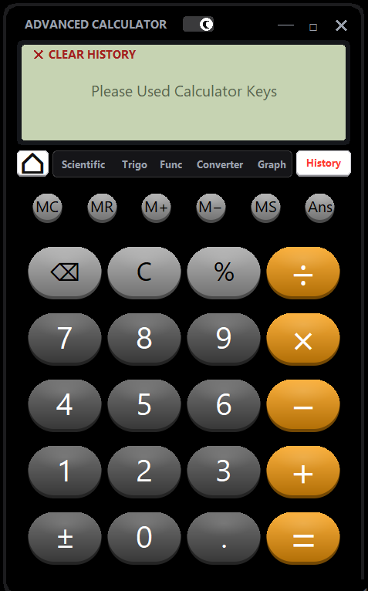
Calculation History
Auto saved
1
Every result is stored with its expression.
Tap to reuse
2
Tap any entry to put its result back on screen.
Easy control
3
Scroll with the mouse wheel; clear from the header.

Slide 12
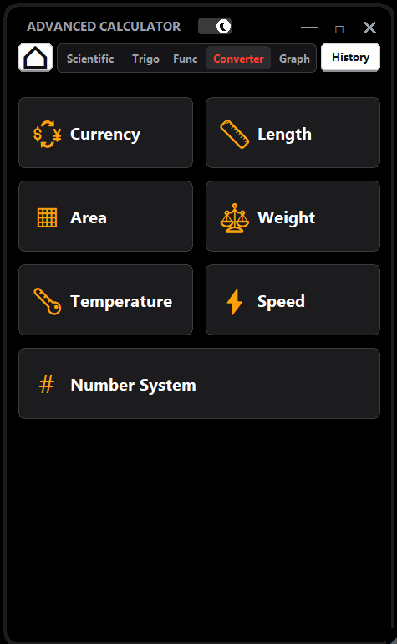
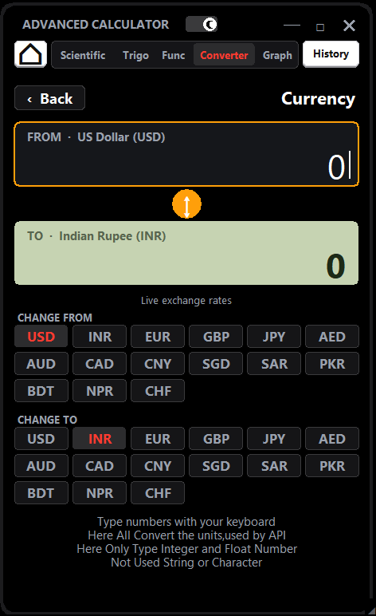
Converter
7 categories
1
Currency, length, area, weight, temperature, speed, number system.
Live currency
2
Rates load from an online API, with offline backup rates.
Quick swap
3
Swap From and To units with one tap or the Tab key.

Slide 13
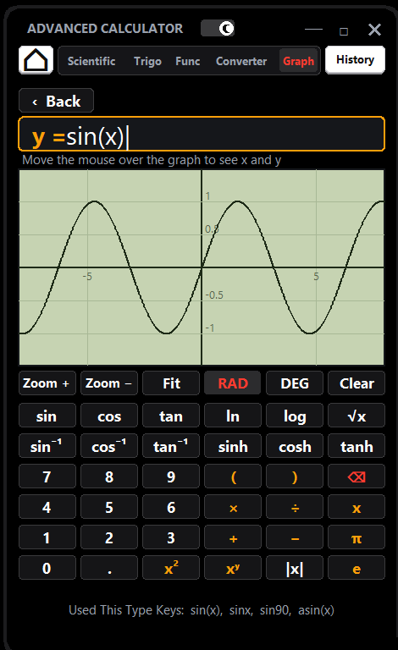
Maths Graph
Type a function
1
Write sinx, x^2 or ln(x) and the curve is drawn.
Zoom and pan
2
Mouse wheel zoom, drag to move, hover to read x and y.
Smart view
3
Auto-fit range and a RAD / DEG switch.

Slide 14
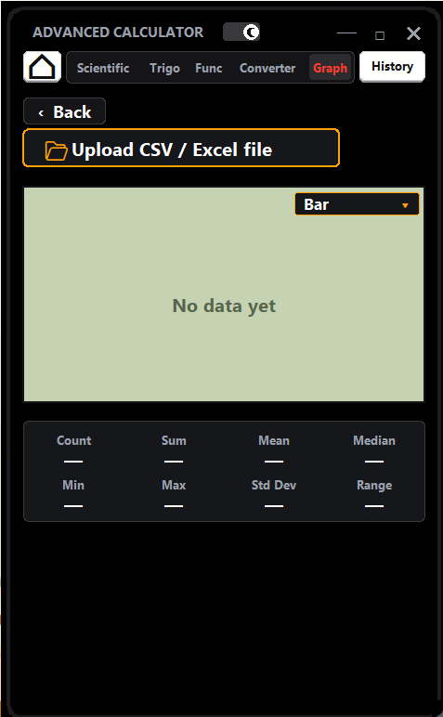
Data Graph
Upload your data
1
Load a CSV, TXT or Excel .xlsx file, or paste a table.
10 chart types
2
Bar, Stacked Bar, Horizontal Bar, Line, Area, Scatter, Pie, Donut, Histogram and Radar.
Auto statistics
3
Count, Sum, Mean, Median, Min, Max, Std Dev and Range.
Notes:
Replace the dashed box with a screenshot of the Data Graph screen after uploading a CSV or Excel file.

Slide 15
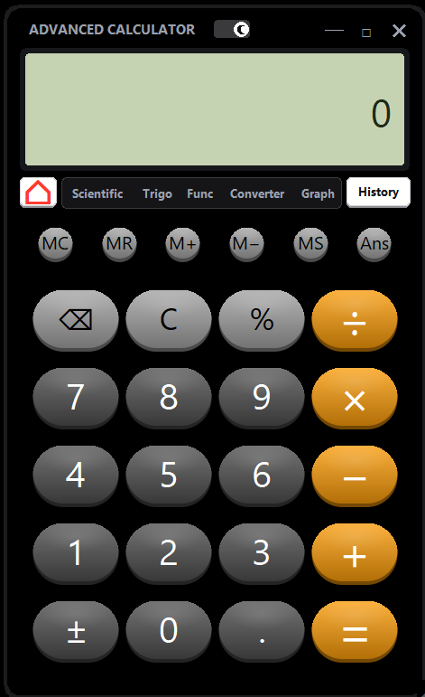
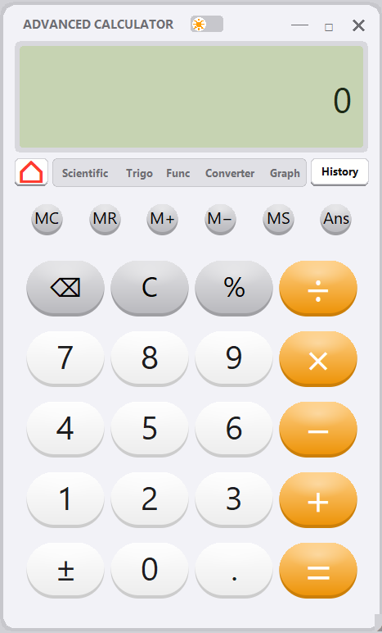
Dark and Light Theme
One-click switch
1
A small switch on the title bar changes the whole look.
Dark theme
2
Black body with grey 3D keys and orange operators.
Light theme
3
Soft white body with bright keys; the LCD stays green.

Slide 16
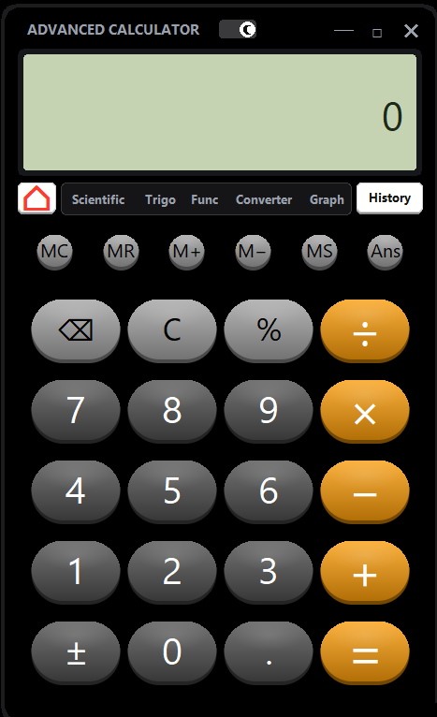
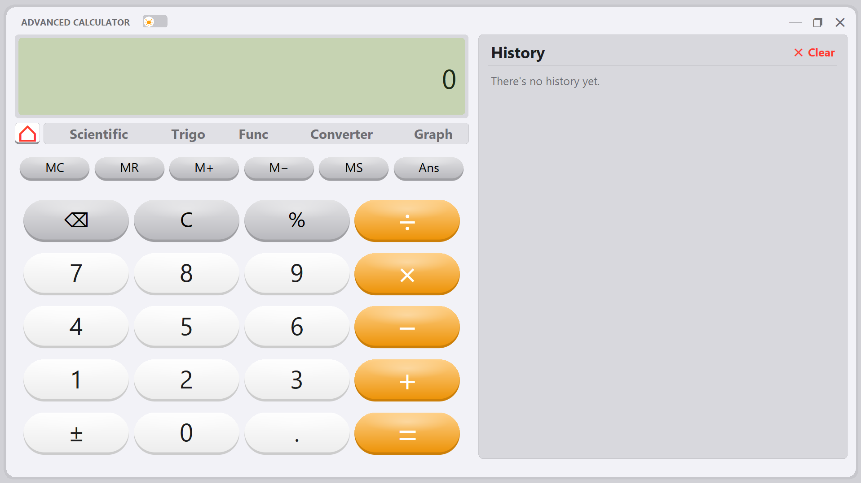
Window Mode
Normal mode
1
Tall window: the calculator fills it and History is a tab.
Window mode
2
Make the window wider: a History panel opens on the right.
Resize and maximize
3
Own minimize, maximize and close buttons; drag the corner to resize.

Slide 17
How It Works
Input
prepare()
safe_eval()
fmt()
Display
Buttons or keyboard
Cleans the text
Computes safely
Formats the number
LCD and History
Why ast, not eval()
Code layout
Only allowed math nodes are run, so no outside Python code can be injected.
Math helper functions, the Calculator class and a Canvas-drawn Tkinter interface.

Slide 18
Challenges
1 Currency API
2 CSV data in Data Graph
3 Maths Graph
PROBLEM
PROBLEM
PROBLEM
Live rates did not load; the API link failed.
Uploaded data showed wrong values.
tan(x) drew false lines; sinx was not understood.
FIX
FIX
FIX
Auto separator and header, symbol cleaning, .xlsx read via ZIP + XML.
clip_y() splits broken lines and gprep() adds the missing brackets.
Free key-less API, a thread with 6 s timeout, and offline backup rates.
RESULT
RESULT
RESULT
CSV, Excel and pasted data plot correctly.
tan(x) draws clean; sinx and sin90 work.
Live rates when online, offline rates otherwise.
API and graph challenges solved step by step
Notes:
Three real problems: the currency API link, CSV/Excel data in the Data Graph, and plotting tan(x) / sinx in the Maths Graph.

Slide 19
Thank You

